Slide 1
The Kalamazoo Route Planner Project
Client: Dustin Black
Members: Austin Miller, Bjarne Wilken, Christian Fuentes, Matthew Phillips, Mike Henke

Slide 2
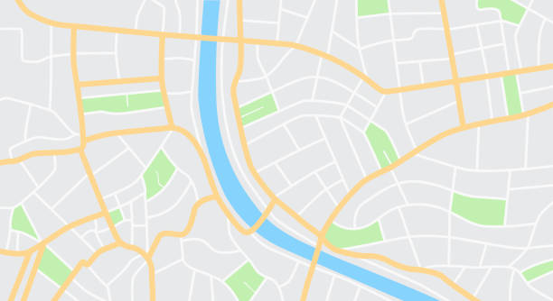
About the Project

Slide 3
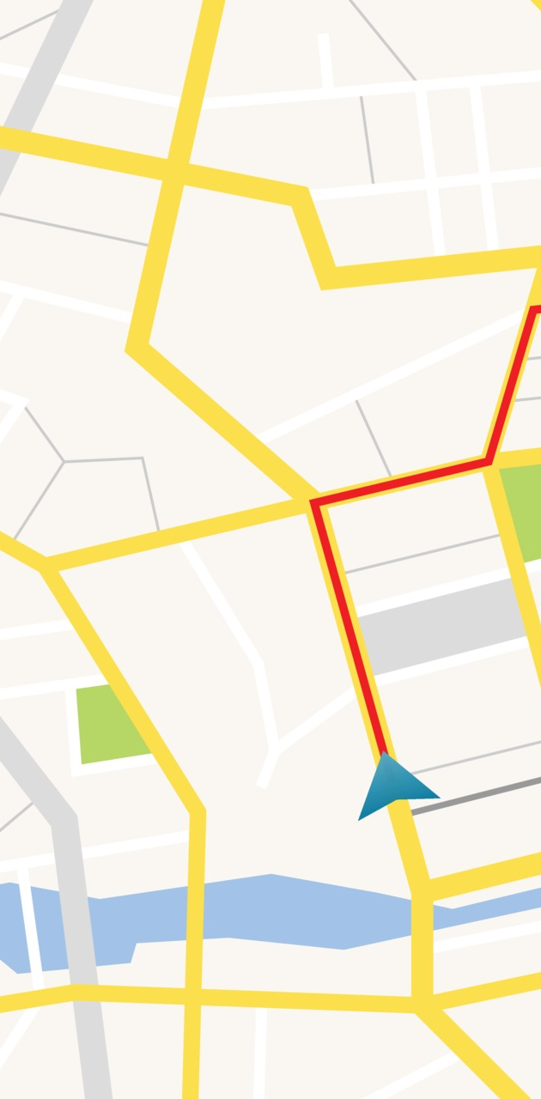
Gps traveling of Kalamazoo
Our Client has asked our group to make a custom GPS website for the people of Kalamazoo for getting to a location by either:
Walking
Bicycle
Bus

Slide 4

The Client has asked us to make to make a check box system so user can select areas by the following:
Bus Stops
Bicycle Racks
Bars and Restaurants
Restrooms
Drinking fountains
Grocery stores
Pharmacies
Cafes
Book stores and public libraries
Etc…

Slide 5
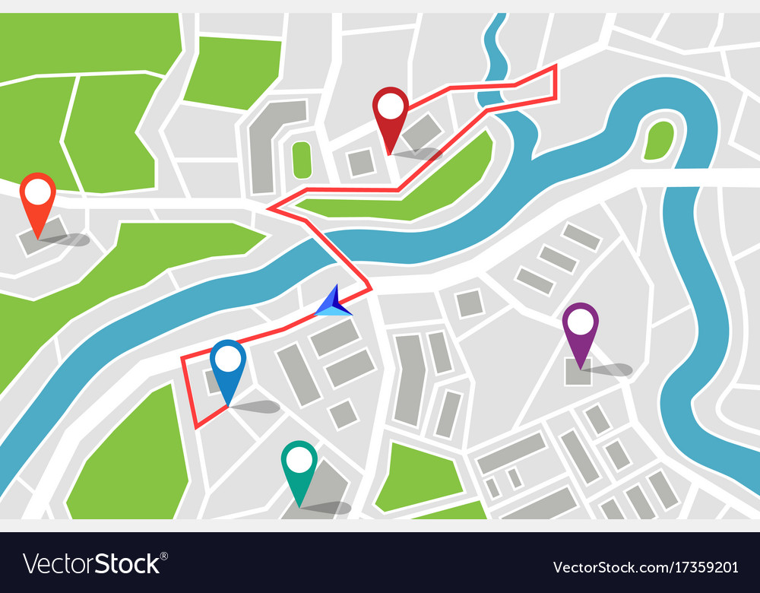
We are also making Check box for the following road groups:
Bicycle Trails
On-street bike lanes
Walking Paths
Bus Routes

Slide 6

Requirements

Slide 7
Functional Requirements:
The software shall plan a route for cycle/transit based on 2 nodes that the user will enter on a map of Kalamazoo.
The software shall use different data structures to store the necessary data collected from the user and from the open-source data (What data structures are still being determined).
The software will then use a pathfinding algorithm with the data collected to compute either the shortest or most time efficient route.
The pathfinding algorithm will also consider the user input such as travel methods, road types, and amenities and will reroute the user if required.
The software shall then display the route to the user via a line along the roads from start node to end node and will display turn-by-turn directions to the user.

Slide 8

User Interface Requirements:
The software shall display a map of Kalamazoo so that the user will be able to zoom, scroll, and place nodes. The software shall allow the user to mark checkboxes to dictate what roads, bike lanes or not, and add or remove layers that would add amenities to the map, like stores.
Capabilities Requirements:
The software should take 15-30 seconds to plan and should run on chrome, firefox and safari.
Software Interface Requirements:
The software shall connect to the OpenStreetMap (OSM) API, Overpass API, and a database linked to all the data on OSM.

Slide 9
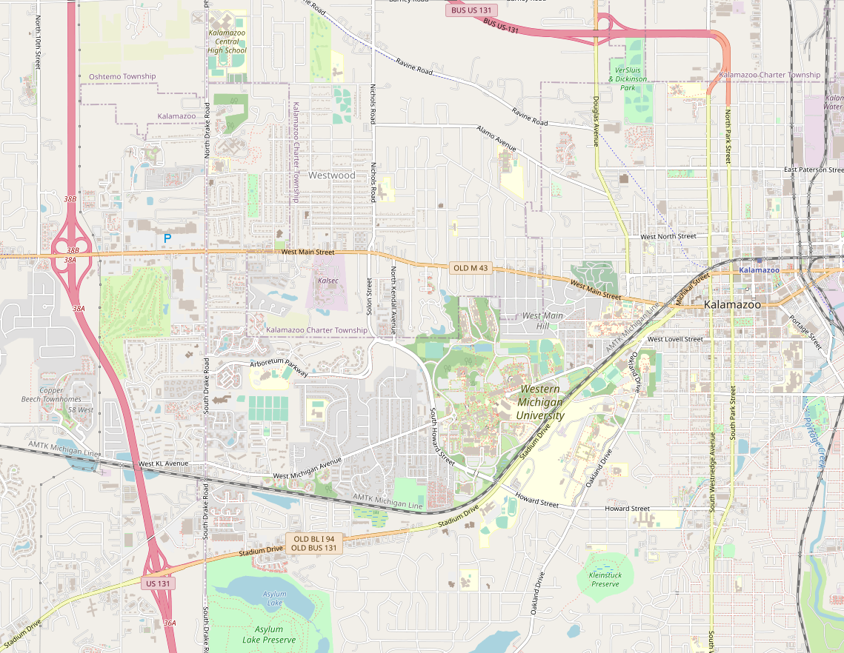
Software Input/Outputs and Data Requirements:
The software shall take the start and end points from the user on the map. The software shall allow the user to select different road options via checkboxes. These road options include busy or not busy and bike lanes or no bike lanes. The software shall output a series of directions in the web browser next to the map or drawn on the map. The route will be able to be exported via CSV. The software shall also take in data from the OSM API/database to compute the route.
Installation and Maintenance Requirements:
The software should be able to handle a change in routes based on changes to the real-life environment. Still currently working on this requirement.

Slide 10

Current Plans

Slide 11

Pre-Production to production
Currently we are testing various coding languages for Open Street Map, because Open Street Map can be used with any language.
Currently testing languages, C, Python, and JavaScript. Most likely the group will be going JavaScript for the majority project
Need to check how to get data from Open Street Map Python Tools
Need to ask the Client about the severs when the when set up the next meeting with our client.
Then we can start working on the project

Slide 12
Flask
What is Flask
Micro web framework
Python library
Popular with many large websites
Advantages of Flask
Lightweight
Doesn't depend on external libraries
Provides needed functionality without extra features
Integrated debugging
Easy to write
Quick development time

Slide 13
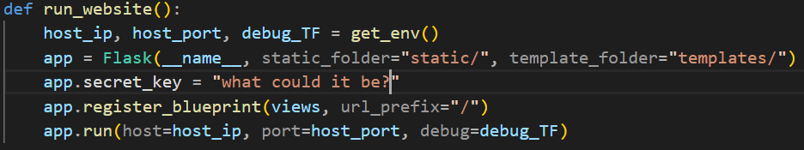
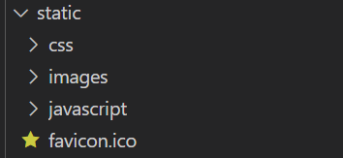
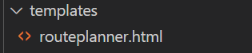
Flask
Flask programs have a specific file structure needed to run the website. Files are divided into two separate folders static and templates. The static folder is meant for files that won't change when running the site. On the other hand the templates folder if meant for html files.

Slide 14
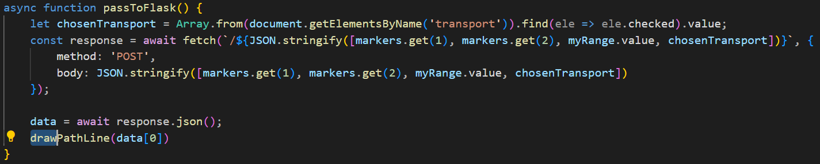
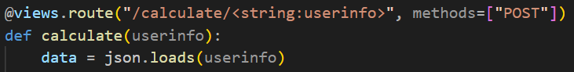
Flask
This is how data is passed from the frontend to the backend. First the data that we want to send to the server is put into JSON format and then posted to the server. The data is then loaded and transformed back into a Python list so we can use it. Then its sent back to the server where the frontend is waiting for it.

Slide 15
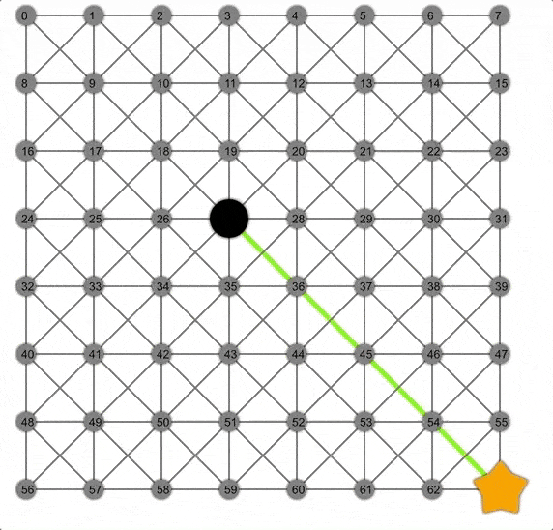
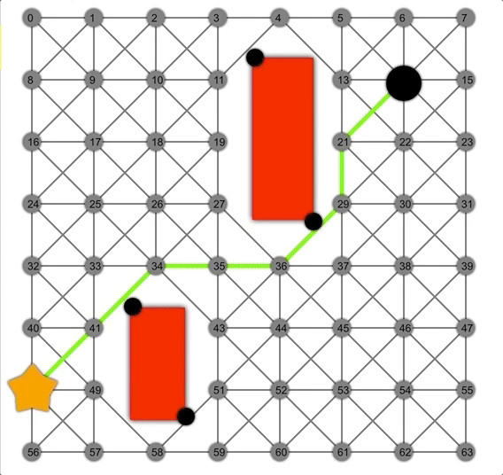
A* Pathfinding Algorithm
Why A*
Although there are many different pathfinding algorithms A* was the obvious choice for our project. With the size of the search area and the amount of nodes a different algorithm such as Dijkstras would take way too much time as it doesn't make any distinction to which node it expands. A* on the other hand does, so it will prioritize moving to nodes that are closer to the goal.

Slide 16
A* Pathfinding Algorithm
How it works
You have two lists one for nodes that haven't been expanded to yet and ones for nodes that have been. You start by adding the first node to the open list
Each iteration it takes the node from the open list with the smallest f value and makes that the current node
The f value is just the sum of two different values
g: the distance from the start to the current node following the path
h: the distance from the current node to the target node
Get the neighbors for the current node based on transport type
For each of the neighbors it checks to see if it’s the target if not it calculates the g and h values and checks it against the lists to make sure that node isn't already available with a better score. If there isn't then it adds that neighbor to the open list.
Lastly it adds the current node to the closed list and repeats until the target is found.

Slide 17
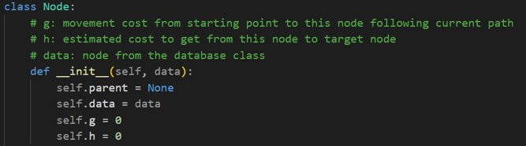
A* Pathfinding Algorithm
To get the distance between nodes we used a function from the Python GeoPy library to calculate the Euclidean distance between the two given coordinates
When getting the neighbors for the current node we also take into account a risk tolerance based on the type of road and how busy it usually is.
Once the target node is found we use a recursive function to get all of that nodes parents to return their data attribute to later turn into a list of longitudes and latitudes to draw the line on the map.
To make this work with our database we created a class to store the information needed at each node for the algorithm.

Slide 18

Thank you
Any Questions?

